Slide 1
Residual Networks
Outline
by Alexander Kowsik

Slide 2
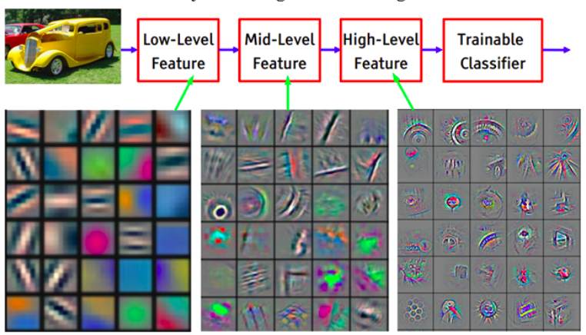
Outline
Introduction/Motivation
layers learn increasingly abstract features
idea: more layers = better performance
problem: vanishing/exploding gradients → at some point, networks not trainable anymore (25+ layer) → error rate increases
solution: ResNets
Residual Networks
allows training for DEEP networks (up to 2000 layers)
main idea: skip connections
skip connections can be identity function
rough idea: if layer hurts performance: “skip” it

Slide 3
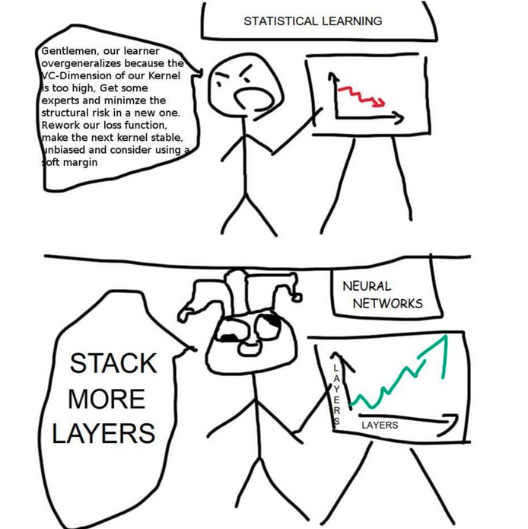
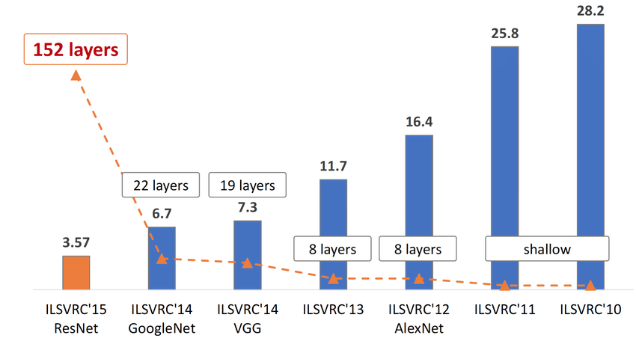
Outline
Introduction/Motivation
layers learn increasingly abstract features
idea: more layers = better performance
problem: vanishing/exploding gradients → at some point, networks not trainable anymore (25+ layer) → error rate increases
solution: ResNets
Residual Networks
allows training for DEEP networks (up to 2000 layers)
main idea: skip connections
skip connections can be identity function
rough idea: if layer hurts performance: “skip” it

Slide 4
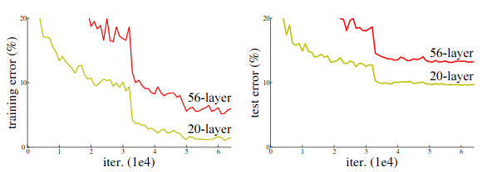
Outline
Introduction/Motivation
layers learn increasingly abstract features
idea: more layers = better performance
problem: vanishing/exploding gradients → at some point, networks not trainable anymore (25+ layer) → error rate increases
solution: ResNets
Residual Networks
allows training for DEEP networks (up to 2000 layers)
main idea: skip connections
skip connections can be identity function
rough idea: if layer hurts performance: “skip” it

Slide 5
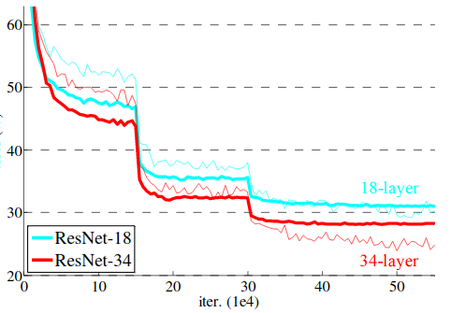
Outline
Introduction/Motivation
layers learn increasingly abstract features
idea: more layers = better performance
problem: vanishing/exploding gradients → at some point, networks not trainable anymore (25+ layer) → error rate increases
solution: ResNets
Residual Networks
allows training for DEEP networks (up to 2000 layers)
main idea: skip connections
skip connections can be identity function
rough idea: if layer hurts performance: “skip” it

Slide 6
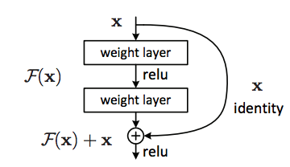
Outline
Introduction/Motivation
layers learn increasingly abstract features
idea: more layers = better performance
problem: vanishing/exploding gradients → at some point, networks not trainable anymore (25+ layer) → error rate increases
solution: ResNets
Residual Networks
allows training for DEEP networks (up to 2000 layers)
main idea: skip connections
skip connections can be identity function
rough idea: if layer hurts performance: “skip” it

Slide 7
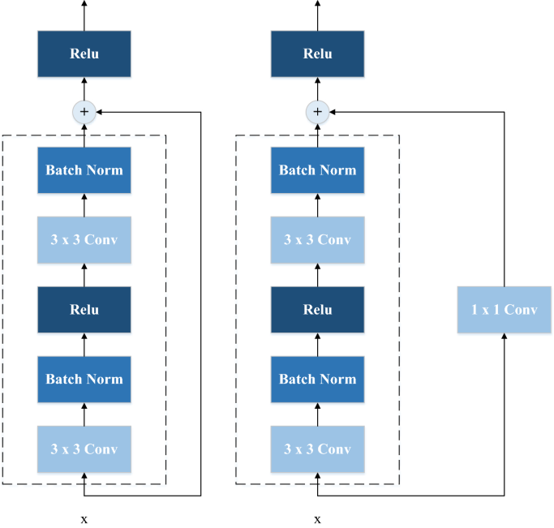
Outline
Structure/Variants
structure in detail (ReLU before/after skip connection, …)
skip distances
dimension differences + solutions: 1x1 convolutions, padding, pooling, ...
different network architectures (HighwayNets, DenseNets, …)
ResNets Internals
Forward propagation
Backprop
Training of ResNets: Gradient Descent, …
advantages/disadvantages/performances
Summary/Conclusion

Slide 8
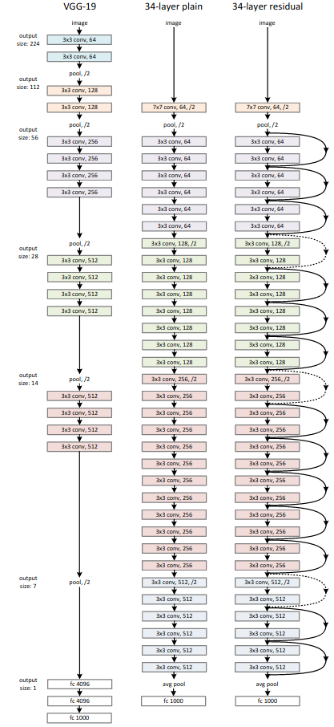
Outline
Structure/Variants
structure in detail (ReLU before/after skip connection, …)
skip distances
dimension differences + solutions: 1x1 convolutions, padding, pooling, ...
different network architectures (HighwayNets, DenseNets, …)
ResNets Internals
Forward propagation
Backprop
Training of ResNets: Gradient Descent, …
advantages/disadvantages/performances
Summary/Conclusion

Slide 9
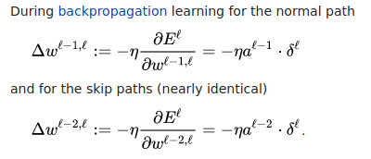
Outline
Structure/Variants
structure in detail (ReLU before/after skip connection, …)
skip distances
dimension differences + solutions: 1x1 convolutions, padding, pooling, ...
different network architectures (HighwayNets, DenseNets, …)
ResNets Internals
Forward propagation
Backprop
Training of ResNets: Gradient Descent, …
advantages/disadvantages/performances
Summary/Conclusion

Slide 10

Structure of the site
site will be built with pandoc
video at the top (kdenlive?)
slides with powerpoint
presentation of the topic
rest of site: topic in detail
written elaboration
supportive graphics and diagrams (maybe animations or interactive elements if possible)
goal: something similar to distill.pub articles

